Slide 1

VACCINATION PORTAL
By- Kishan Tripathi
2nd Year. CSE B2
University roll no.
2102220100095

Slide 2
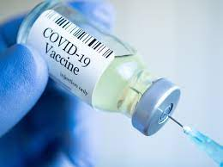
CONTENTS
Introduction
References
Working

Slide 3


INTRODUCTION
This is an online COVID-19 booking slot in which we can go to our district or any other district and get vaccinated.
This project will be hugely helpful to people in Need of urgent vaccination in their locality.

Slide 4
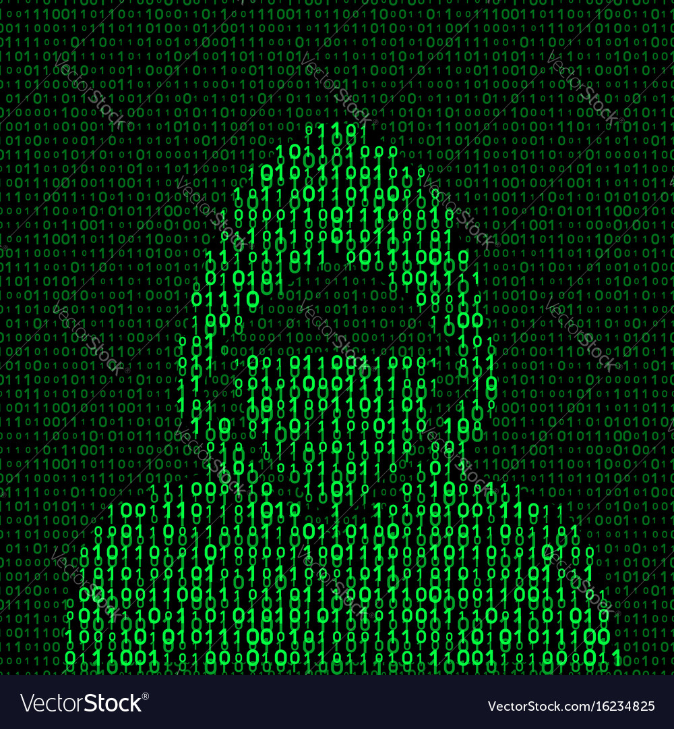
REFERENCES
Apisetu.gov.in
Python.org
Code academy
Tutorialspoint.com
Google’s Python Class
LearnPython.org

Slide 5

WORKING
Getting otp.
Asking for location and date.
Generating current date.
Dates in format.
Checking for valid date.
Checking whether working or not.
Vaccine selection.
Getting Appointment list.
Booking Venue.
Dose selection.
Slot Booking.
Generating random number.

Slide 6

THANK YOU
By- Kishan Tripathi
2nd Year. CSE B2
University roll no.
2102220100095

